Slide 1
Design Patterns
By using the design patterns you can make your code more flexible, reusable and maintainable. It is the most important part because java internally follows design patterns.
Advantage of design pattern:
They provide the solutions that help to define the system architecture.
They provide transparency to the design of an application.

Slide 2
Core Java Design Patterns
Creational Design Pattern
Structural Design Pattern
Behavioral Design Pattern

Slide 3
A. Creational Design Patterns
Creational design patterns are concerned with the way of creating objects. These design patterns are used when a decision must be made at the time of instantiation of a class (i.e. creating an object of a class). Sometimes, the nature of the object must be changed according to the nature of the program. In such cases, we must get the help of creational design patterns to provide more general and flexible approach.
Factory Pattern
Abstract Factory Pattern
Singleton Pattern
Prototype Pattern
Builder Pattern.

Slide 4
1. Factory Pattern
A Factory Pattern or Factory Method Pattern says that just define an interface or abstract class for creating an object but let the subclasses decide which class to instantiate. In other words, subclasses are responsible to create the instance of the class.The Factory Method Pattern is also known as Virtual Constructor.
Advantage of Factory Design Pattern
Factory Method Pattern allows the sub-classes to choose the type of objects to create.
It promotes the loose-coupling by eliminating the need to bind application-specific classes into the code. That means the code interacts solely with the resultant interface or abstract class, so that it will work with any classes that implement that interface or that extends that abstract class.
Usage of Factory Design Pattern
When a class doesn't know what sub-classes will be required to create
When a class wants that its sub-classes specify the objects to be created.
When the parent classes choose the creation of objects to its sub-classes.

Slide 5
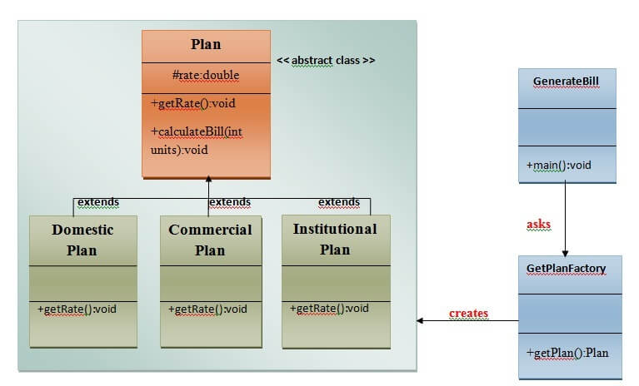
1. Factory Pattern

Slide 6
2. Abstract Factory Pattern
Abstract Factory Pattern says that just define an interface or abstract class for creating families of related (or dependent) objects but without specifying their concrete sub-classes.That means Abstract Factory lets a class returns a factory of classes. So, this is the reason that Abstract Factory Pattern is one level higher than the Factory Pattern.An Abstract Factory Pattern is also known as Kit.
Advantage of Abstract Factory Pattern
Abstract Factory Pattern isolates the client code from concrete (implementation) classes.
It eases the exchanging of object families.
It promotes consistency among objects.
Usage of Abstract Factory Pattern
When the system needs to be independent of how its object are created, composed, and represented.
When the family of related objects has to be used together, then this constraint needs to be enforced.
When you want to provide a library of objects that does not show implementations and only reveals interfaces.
When the system needs to be configured with one of a multiple family of objects.

Slide 7
2. Abstract Factory Pattern
UML for Abstract Factory Pattern
We are going to create a Bank interface and a Loan abstract class as well as their sub-classes.
Then we will create AbstractFactory class as next step.
Then after we will create concrete classes, BankFactory, and LoanFactory that will extends AbstractFactory class
After that, AbstractFactoryPatternExample class uses the FactoryCreator to get an object of AbstractFactory class.
See the diagram carefully which is given below:

Slide 8
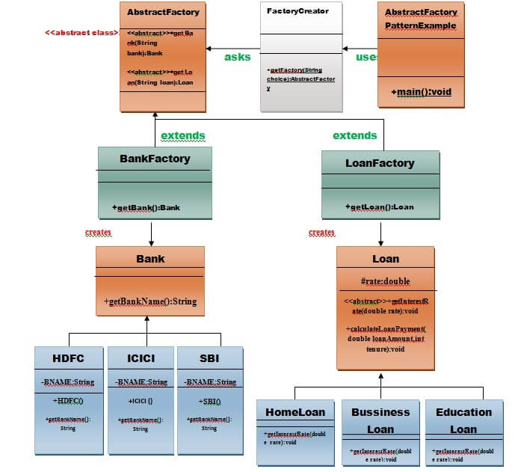
2. Abstract Factory Pattern

Slide 9
3. Singleton Design Pattern
Singleton Pattern says that just “ define a class that has only one instance and provides a global point of access to it “. In other words, a class must ensure that only single instance should be created and single object can be used by all other classes.
There are two forms of singleton design pattern
Early Instantiation: creation of instance at load time.
Lazy Instantiation: creation of instance when required.
Advantage of Singleton design pattern
Saves memory because object is not created at each request. Only single instance is reused again and again.
Usage of Singleton design pattern
Singleton pattern is mostly used in multi-threaded and database applications. It is used in logging, caching, thread pools, configuration settings etc.
How to create Singleton design pattern?
To create the singleton class, we need to have static member of class, private constructor and static factory method.
Static member: It gets memory only once because of static, itcontains the instance of the Singleton class.
Private constructor: It will prevent to instantiate the Singleton class from outside the class.
Static factory method: This provides the global point of access to the Singleton object and returns the instance to the caller.

Slide 10
3. Singleton Design Pattern
Understanding early Instantiation of Singleton Pattern -
In such case, we create the instance of the class at the time of declaring the static data member, so instance of the class is created at the time of classloading.
class A{
private static A obj=new A();//Early, instance will be created at load time
private A(){}
public static A getA(){
return obj;
}
public void doSomething(){
}
}

Slide 11
3. Singleton Design Pattern
Understanding lazy Instantiation of Singleton Pattern
In such case, we create the instance of the class in synchronized method or synchronized block, so instance of the class is created when required.
class A{
private static A obj;
private A(){}
public static A getA(){
if (obj == null){
synchronized(Singleton.class){
if (obj == null){
obj = new Singleton();//instance will be created at request time
}
}
}
return obj;
}
public void doSomething(){
//write your code
}
}

Slide 12
4. Prototype Design Pattern
Prototype Pattern says that cloning of an existing object instead of creating new one and can also be customized as per the requirement. This pattern should be followed, if the cost of creating a new object is expensive and resource intensive.
Advantage of Prototype Pattern
The main advantages of prototype pattern are as follows:
It reduces the need of sub-classing.
It hides complexities of creating objects.
The clients can get new objects without knowing which type of object it will be.
It lets you add or remove objects at runtime.
Usage of Prototype Pattern
When the classes are instantiated at runtime.
When the cost of creating an object is expensive or complicated.
When you want to keep the number of classes in an application minimum.
When the client application needs to be unaware of object creation and representation.

Slide 13
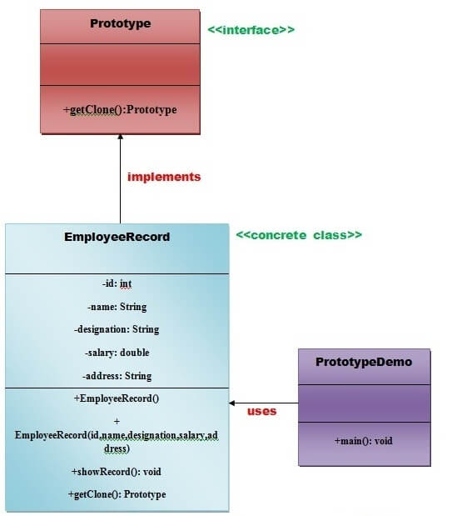
4. Prototype Design Pattern

Slide 14
5. Builder Design Pattern
Builder Pattern says that "construct a complex object from simple objects using step-by-step approach"It is mostly used when object can't be created in single step like in the de-serialization of a complex object.
Advantage of Builder Design Pattern
The main advantages of Builder Pattern are as follows:
It provides clear separation between the construction and representation of an object.
It provides better control over construction process.
It supports to change the internal representation of objects.

Slide 15
6. Object Pool Pattern
Mostly, performance is the key issue during the software development and the object creation, which may be a costly step. Object Pool Pattern says that " to reuse the object that are expensive to create". Basically, an Object pool is a container which contains a specified amount of objects. When an object is taken from the pool, it is not available in the pool until it is put back. Objects in the pool have a lifecycle: creation, validation and destroy. A pool helps to manage available resources in a better way. There are many using examples: especially in application servers there are data source pools, thread pools etc.
Advantage of Object Pool design pattern
It boosts the performance of the application significantly.
It is most effective in a situation where the rate of initializing a class instance is high.
It manages the connections and provides a way to reuse and share them.
It can also provide the limit for the maximum number of objects that can be created.
Usage:
When an application requires objects which are expensive to create. Eg: there is a need of opening too many connections for the database then it takes too longer to create a new one and the database server will be overloaded.
When there are several clients who need the same resource at different times.

Slide 16
B. Structural Design Pattern

Slide 17
1. Adapter Pattern
An Adapter Pattern says that just "converts the interface of a class into another interface that a client wants". In other words, to provide the interface according to client requirement while using the services of a class with a different interface. The Adapter Pattern is also known as Wrapper.
Advantage of Adapter Pattern
It allows two or more previously incompatible objects to interact.
It allows reusability of existing functionality.
Usage of Adapter pattern:
It is used:
When an object needs to utilize an existing class with an incompatible interface.
When you want to create a reusable class that cooperates with classes which don't have compatible interfaces.
When you want to create a reusable class that cooperates with classes which don't have compatible interfaces.

Slide 18
1. Adapter Pattern
UML for Adapter Pattern:
There are the following specifications for the adapter pattern:
Target Interface: This is the desired interface class which will be used by the clients.
Adapter class: This class is a wrapper class which implements the desired target interface and modifies the specific request available from the Adaptee class.
Adaptee class: This is the class which is used by the Adapter class to reuse the existing functionality and modify them for desired use.
Client: This class will interact with the Adapter class.

Slide 19
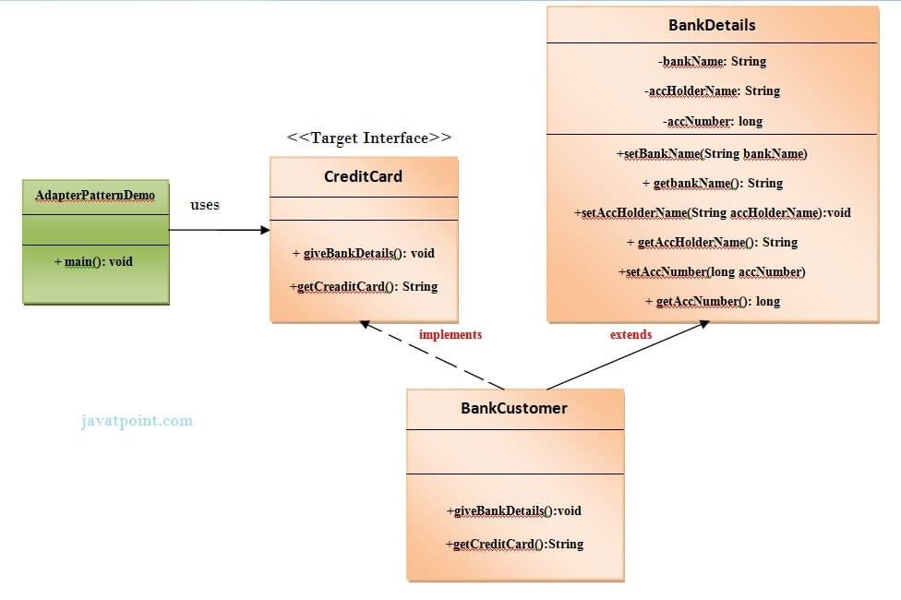
1. Adapter Pattern

